Slide 1
COTING AND THE VALUE CHAIN
(Financial Accounting)
Muhammad Ayaz Attari : BSE-22s-080
Muhammad Mubashir : BSE-22s-084
Muhammad Ehtesham : BSE-22s-150
Muhammad Talha : BSE-22s-095
Course Instructor : Miss Seema

Slide 2
TABLE OF CONTENT
1. Cost Accounting- Meaning 4
2. Definition 5
3. OBJECTIVES OF COST ACCOUNTING 6
4. COST TERMINOLOGY 7
5. ELEMENTS OF COST 8
6. COST CLASSIFICATION 9
7. ON THE BASIS OF NATURE 10
8. ON THE BASIS OF FUNCTION 11
9. ON THE BASIS OF VARIABILITY 12
8.

Slide 3
10. ON THE BASIS OF CONTROLLABILITY 13
11. ON THE BASIS OF TIME: 14
12. Value-Chain Analysis 15
13. The Value Chain System 16
14. Primary activities 17
15. Support activities 18
15. Porter’s Value Chain Model 19
16. Value Chains in Service Industries 20

Slide 4
Cost Accounting- Meaning
Cost accounting is concerned with recording, classifying and summarizing costs for determination of costs of products or services, planning, controlling and reducing such costs and furnishing of information to management for decision making

Slide 5
Definition
Cost accountancy” as the application of costing and cost accounting principles, method and techniques to the science, art and practice of cost control and the ascertainment of profitability

Slide 6
OBJECTIVES OF COST ACCOUNTING
Ascertainment of costs
Estimation of costs
Cost control
Cost reduction
Determining selling price
Facilitating preparation of financial and other statement
Providing basis for operating policy

Slide 7
COST TERMINOLOGY
COST: Cost means the amount of expenditure incurred on a particular thing.
COSTING: Costing means the process of ascertainment of costs.
COST ACCOUNTING: The application of cost control methods and the ascertainment of the profitability of activities carried out or planned”.
COST CONTROL: Cost control means the control of costs by management. Following are the aspects or stages of cost control.
JOB COSTING: It helps in finding out the cost of production of every order and thus helps in ascertaining profit or loss made out on its execution. The management can judge the profitability of each job and decide its future courses of action.
BATCH COSTING: Batch costing production is done in batches and each batch consists of a number of units, the determination of optimum quantity to constitute an economical batch is all the more important.

Slide 8
ELEMENTS OF COST
Element of cost
Materials Labour Expenses
Direct Indirect
Direct Indirect
Direct Indirect

Slide 9
COST CLASSIFICATION
Classification On basis of :
Nature
Function
Direct & indirect
Variability
Controllability
TimE

Slide 10
ON THE BASIS OF NATURE
Materials
Labor
Expenses

Slide 11
ON THE BASIS OF FUNCTION
Manufacturing costs
Commercial costs – ADM and S&D Costs
ON THE BASIS OF DIRECT AND INDIRECT
Direct costs
Indirect costs

Slide 12
ON THE BASIS OF VARIABILITY
Fixed costs
Variable costs
Semi variable costs

Slide 13
ON THE BASIS OF CONTROLLABILITY
Controllable costs
Uncontrollable costs
ON THE BASIS OF NORMALITY
Normal costs
Abnormal costs

Slide 14
ON THE BASIS OF TIME:
Historical costs
Pre determined costs
ON THE BASIS OF PLANNING AND CONTROL
Budgeted costs
Standard costs

Slide 15
Value-Chain Analysis
Value-chain analysis
a strategic analysis of an organization that uses value creating activities.
Value is the amount that buyers are willing to pay for what a firm provides them and is measured by total revenue
Notes:
Creating value for buyers that exceeds the costs of production is a key concept used in analyzing a firm’s competitive position.
Analyzes the cross-functional flow of products or services within an organization that add value to customers

Slide 16
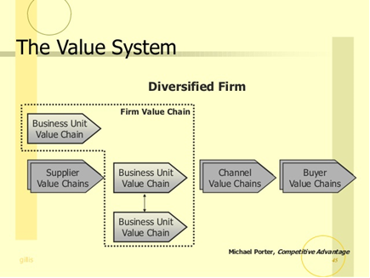
The Value Chain System
Notes:
a means of broadening the effective scope of the firm’s chain.- joint ventures, coalition, licences, supply agreements

Slide 17
Value-Chain Analysis
Primary activities
contribute to the physical creation of the product or service, its sale and transfer to the buyer, and its service after the sale.
inbound logistics, operations, outbound logistics, marketing and sales, and service

Slide 18
Value-Chain Analysis
Support activities
activities of the value chain that either add value by themselves or add value through important relationships with both primary activities and other support activities
procurement, technology development, human resource management, and general administration.

Slide 19
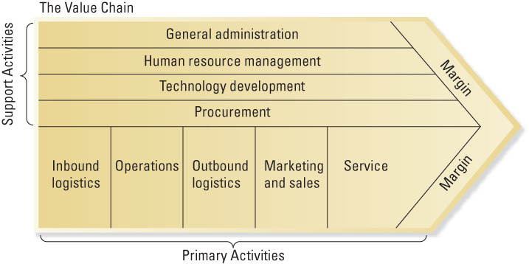
Porter’s Value Chain Model

Slide 20
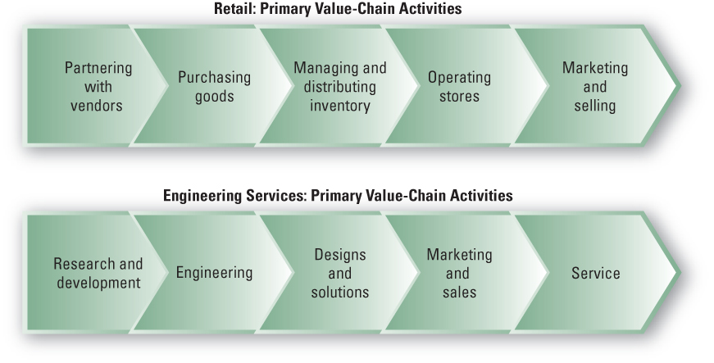
Value Chains in Service Industries

Slide 21
Thank You for Patiently Listening

